Slide 1
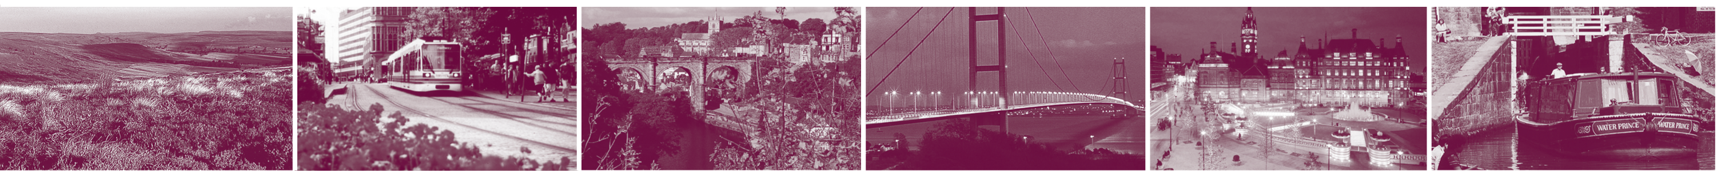
The Regional Resilience Tier
UK Ops Course
4/5 June 2008
Jo Gillespie
Regional Resilience Team
Government Office for Yorkshire and The Humber

Slide 2
Outline
Context – why do we have regional resilience?
What is it?
Expectations of the role of the GO
Experience from recent events

Slide 3
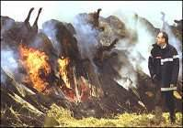
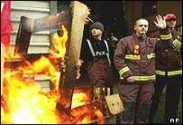
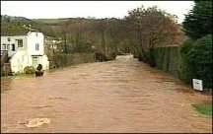
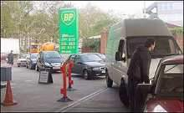

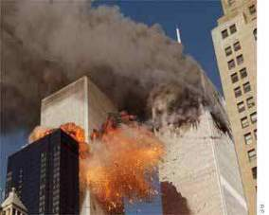
Context - 1
F
F
F
F
Co-ordination?
Scale?
Planning structures
Emergency powers

Slide 4
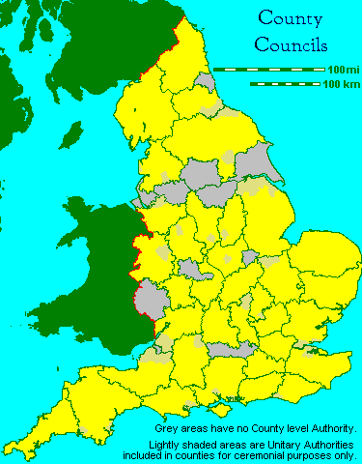
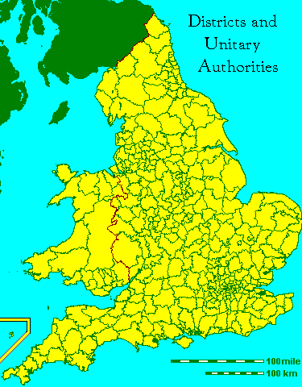
Context - 2

Slide 5
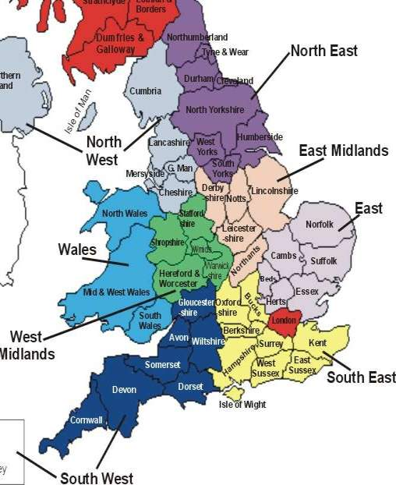
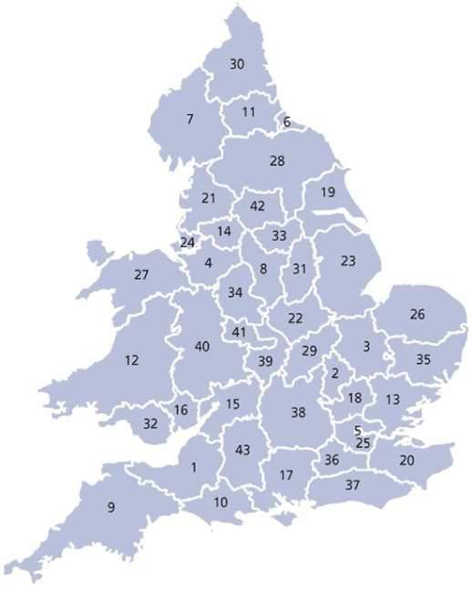
Context - 3
CFOA FIRE BRIGADE AREAS
ACPO POLICE FORCE AREAS

Slide 6
Context - 4
9 Government Office regions
Work for 11 Government Departments
Engaged with local stakeholders
Familiar with their regions
North
East
North
West
Yorkshire
& Humber
East
Midlands
West
Midlands
East of
England
South West
South East

Slide 7
Civil Contingencies Act
Why did we legislate?
Local response is the building block of UK resilience
Embraces a wide range and a large number of players:
  Local authorities (400+)
  National Health Service bodies (600+)
  Emergency services (40+ police, fire, ambulance)
We therefore need to give local responders:
  A clear set of roles and responsibilities
  Clear structures for multi-agency co-ordination
  A robust performance management framework
Civil Defence Act 1947 no longer fit-for-purpose

Slide 8
Who is subject to the duties?
Differential set of duties
Category 1 responders:
  “Core responders”
  E.g. emergency services, local authorities, range of NHS bodies, EA, HPA
Category 2 responders
  “Co-operating responders”
  E.g. water, energy, telecommunications companies
But not an exclusive framework:
  Voluntary sector
  Armed Forces

Slide 9
What does the Act require?
Category 1 responders
  Risk assessment
  Emergency planning
  Business Continuity Management
  Communicating with the public (i.e. raising public awareness, warning and informing)
  Co-operation and information sharing
Category 2 responders
  Co-operation and information sharing
Local authorities only
  Advice and assistance to businesses

Slide 10
How is performance assessed?
Rejected the idea of a “Civil Contingencies Inspectorate”
Performance assessment performed by mainstream audit bodies:
  Police = HM Inspectorate of Constabulary
  Local authorities = Audit Commission
  Healthcare Commission = NHS bodies
CCS working to ensure consistency of approach
Will raise the profile of civil protection and bring it into the mainstream

Slide 11
RRT Role – Planning Phase
Lead and Secretariat for Regional Resilience Forums (RRFs);
Liaison with Local Resilience Forums (LRFs);
The interface between central Government + local responders; gateway for communications;
Identifying region wide issues and actioning them;
Helping develop region-wide capability plans as appropriate;
Sharing best practice;
Assisting local responders on agreed workstreams;
Assisting Central Government on certain workstreams (NCS, risk, capabilities, National Working Groups / Shaping Policy);
Capability ‘buddies’;
Exercises
Notes:
VA2 RRT Role – Planning Phase – Workstreams – National Capability Survey
Capabilities – Mass Fatalities, Transport, Fuel

Slide 12
RRT Role – Response
Key interface and communication link between central Government + local responders; Reporting template;
The ‘eyes and ears’ of central Government in sub-regional incidents;
Attendance at Gold / Govt Liaison Officer;
Assisting with briefing / Ministerial / VIP visits during an incident;
Media engagement and support to Regional Minister;
Potential activation of RCCC (only to be used if it can add value. Limited list of wide area / high impact emergencies;
Co-ordination of mutual aid requests and central support;
Assistance / leading debriefs;
Support during the recovery phase.

Slide 13
Regional Resilience Forum
Purpose:
To provide multi-agency strategic direction to civil protection planning at a regional level.
Terms of reference:
  Improving co-ordination at a regional level
  Improving co-ordination between the Centre and the Region
  Improving co-ordination between the regional and local response capability
  Improving co-ordination between Regions
  Supporting planning for a response capability
  Assisting with recovery

Slide 14
Regional Resilience Forum- Membership
Nick Best Deputy Regional Director Regional Resilience GOYH
David Fraser Deputy Regional Director SARA GOYH
Paul Johnstone Regional Director Public Health, GOYH
Wendy Miller Regional Director Government News Network
John Marsden Chief Executive North Yorkshire County Council
Tony Reeves Chief Executive Bradford MDC
Simon Driver Chief Exec North Lincs Council
Phil Coppard Chief Executive Barnsley Metropolitan Borough Council
Keith Vardy Area Operations Manager Maritime and Coastguard Agency
Sir Norman Bettison Chief Constable West Yorkshire Police
Brigadier David Maddan Army Headquarters 15 (NE) Brigade
Toby Willison Regional Director Environment Agency
Mark Smitherman Chief Fire Officer South Yorkshire Fire & Rescue Service
Martyn Pritchard Chief Executive, Yorkshire Ambulance Service
Iain Lovell Head of Scrutiny & Operations Yorkshire & Humber Assembly
Ruth Gelletlie Director, Health Protection Agency
Ian Temple Operations Manager Red Cross
David Snowball Head of Operations, Health & Safety Executive
Don Stewart Executive Director of Strategy & Policy, Yorkshire Forward

Slide 15
RRF Working Groups
Regional Resilience Forum
Local Resilience Fora
Regional Media Emergency Forum (RMEF)
Local arrangements
Regional Risk Assessment Group
Regional Multi-Agency Resilience Sub-Group
Warning and Informing Group
Voluntary, Community and Faith Sector Forum
LRF Chairs Group
Regional Transport Resilience Forum
Regional Utilities Resilience Forum
Regional Health Emergency Planning and Resilience Forum
Strategic Flooding Working Group
Animal Disease Working Group
Mass Fatalities Working Group
CBRN Working Group
Strategic Flu Group

Slide 16




The UK Resilience Programme
Performance Management
Exercises
Real-life events
Horizon
scanning
Evaluating
Resilience
Systematic risk identification
Identifying risks
Generic Capabilities
Specific Plans
Business Continuity
Crisis Management
Comms
Building
Resilience
Systematic Risk Assessment
Assessing risks
Requirements& Solutions

Slide 17
Principles of the UK Crisis Response
Preparation: well prepared, incl statutory framework defining roles & responsibilities
Continuity: built on everyday working arrangements and principle of Integrated emergency Management
Subsidiarity: delegate decision making. Local response key
Direction: clarity of purpose through engagement of key stakeholders and agreed strategic objectives
Integration: effective co-ordination between & within responders
Communication: effective two-way info flows, incl the public
Co-operation: based on mutual trust and understanding
Anticipation: risk anticipation and analysis

Slide 18
National Arrangements
CONOPs: An Overview
Reflect crucial role of police and other local responders supported, where necessary, by lead Government Department
In such circumstances, need to have fixed points to refer to:
  - Subsidiarity : Only get involved if we can add value
  - Roles and responsibilities of central, regional and local responders, including interaction between them
  - Default starting position for most severe emergencies, irrespective of cause. Some scaling back for lesser challenges. Arrangements will be refined as situation develops
Slow-burn crises will provide time to refine arrangements to meet specific circumstances

Slide 19
National Command & Control
“COBR will be activated in support of the UK Lead Government Department (LGD) in response to any actual or potential catastrophic emergency in the UK or serious emergency in England or on reserved issues elsewhere in Great Britain”
COBR will seek to provide:
Strategic direction
Common Recognised Information Picture
Mobilising help
Prioritisation
Emergency legislation
National intelligence assessments/science
Internal liaison
Public info strategy
Advice on development of emergency

Slide 20
Emergencies not engaging the
COBR Mechanism:
Local emergency
  Cannot be dealt with by the organisations as part of their everyday activities, and might require the involvement of government offices in the regions, but not central departments
  Most locally defined major incidents would fall into this category
  Transport accident, power outage, public order
Significant but narrow focused emergency (level 1)
  As above, but requires immediate central government support primarily from lead government department given narrow focus
  LGD provides any necessary co-ordination from own departmental facilities, or through government offices in the English regions
  prison riot, overseas kidnapping, minor accident at nuclear power plant, bomb causing few casualties or damage

Slide 21
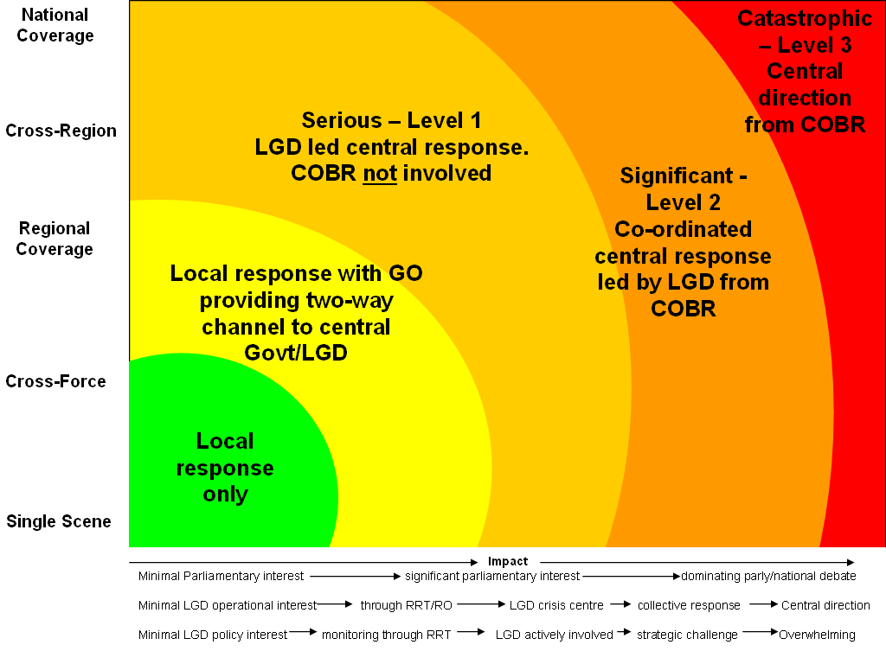
Civil Contingencies Secretariat
Significant – Level 1
Major –
Level 2
Notes:
CONOPS being re-written

Slide 22
Regional Response:
GOs the ‘eyes and ears’ of central Government in sub-regional incidents
Available to attend GOLD, knowledge of locality and key players
Specified role in some Lead Government Department plans
Focus on the recovery phase, avoid duplication of existing lines of communication
A capability to provide regional co-ordination via RCCCs - as required.

Slide 23
Regional Response
Event
Planning
Tip-off
Incident
Crisis
State
of Emergency
Role of RRTs
RRTs
Support
RRFs/
Liaise with Govt
RRTs report
to Lead
Govt Dept
RRTs support RCCC
(+ liaise with Lead Government Department)
RRTs support RNC and RCCC
structure
Role of Regional
tier
RCCC
convened
Watching brief
(Level 1)
RCCC to
Co-ordinate
response
(Level 2)
RNC
Special
Legislative
Powers
(Level 3)
RRFs
meeting

Slide 24
Expectations of the GOs?
A quality conduit for information (intimately acquainted with all local responders).
Will provide rapid information.
Good judgement, will know when to consult Central Govt.
Regular high quality briefing.
A key role in recovery.
Familiar with Lead Department Plans and their roles in them.

Slide 25
Recent Experience - 1
Boscastle:
      Rapid briefing;
      Lots of support to the Local Authority;
      Lots of VIP visits;
      Help with Bellwin;
      Facilitated debrief.
Carlisle:
      Invited to attend Gold
      Lots of briefing
      Established semi-permanent base in the town
      Created mutli-faceted GO taskforce.
      Wrote debrief.

Slide 26
Recent Experience - 2
7 July attacks:
      Attended Gold
      Briefing
      Triggered Mass Fatalities plan for London
      Facilitated the Family Assistance Centre
      Supported the lead local authority.
      Facilitating the lessons learned process.

Slide 27
Recent Experience - 3
Buncefield
Attended Gold
Briefing
Ministerial visits
Liaison with OGDs
Recovery
Lessons identified

Slide 28
JUNE 2007 FLOODING
Yorkshire & Humber, West Midlands, East Midlands, South West
Properties Flooded 29,000 (23,500 Y&H)
Businesses Flooded 4,000 (3,600 Y&H)
Schools Flooded 467 (290 Y&H)

Slide 29
JULY FLOODING
Yorkshire & Humber, West Midlands, East Midlands, South West, South East, London
Properties Flooded 19,500 (99 Y&H)
Businesses Flooded 3,000 (120 Y&H)
Schools 382 (zero Y&H)

Slide 30
ROLE OF GOYH/RRT
1. Rapid briefing.
2. Co-ordination of Ministerial/VIP Visits.
3. GLT Reps at Command Structures.
4. Close Liaison with Local Authority.
5. Close liaison with Met Office, Utility, Military, Environment Agency, RRF, LGD’s, CCS, GNN.
6. Extensive dialogue with Ministers, local MPs.
7. Extensive sourcing of mutual aid.

Slide 31
Role of GOYH/RRT (cont)
8. Supported transition from response to recovery. Facilitated meetings with stakeholders to outline changes to Bellwin Scheme, distribution of £10m for flooded homes, £10m for flooded schools.
Provided advice and guidance to South West and South East in second wave of flooding.
Engaged with sub regional, regional and national lessons learned process.

Slide 32
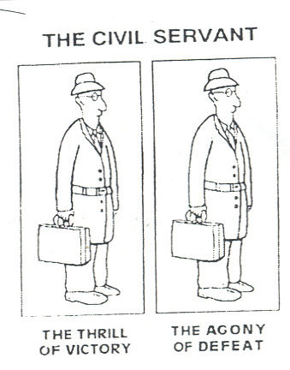
And finally…

